Slide 1
The Wallace Line

Slide 2
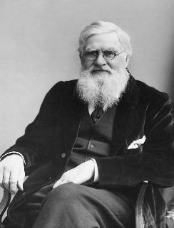
Wallace came up with a similar theory of evolution independently of Charles Darwin. Although Darwin is more famous, Wallace was very important in the formulation of his ideas.

Slide 3
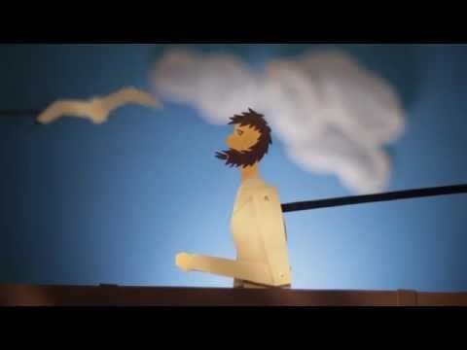

Slide 4
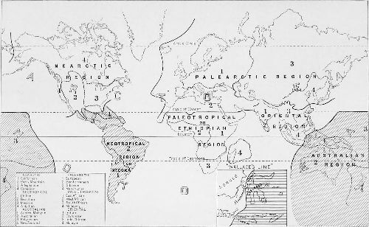
Before his work on evolution, Wallace made an exciting discovery that he is still famous for today.
This discovery was based on biogeography, or differences he observed in plant and animal distribution.
For this discovery, Wallace is often called the Father of Biogeography.

Slide 5
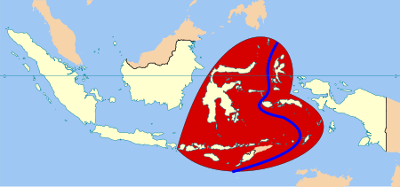
In this lesson, we are going to learn about Wallace's Line and the area of Wallacea.

Slide 6
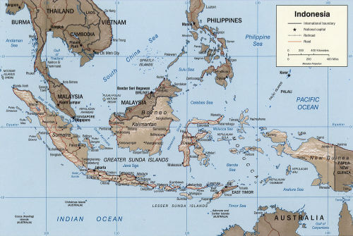
The Malay Archipelago is an area of approximately 13,000 islands between mainland Asia and Australia. The word “archipelago” simply means a group of islands.
Wallace spent eight years exploring the Malay Archipelago in the 19th century. While he was there, he collected a huge range of specimens - from birds and shells to insects and mammals.

Slide 7
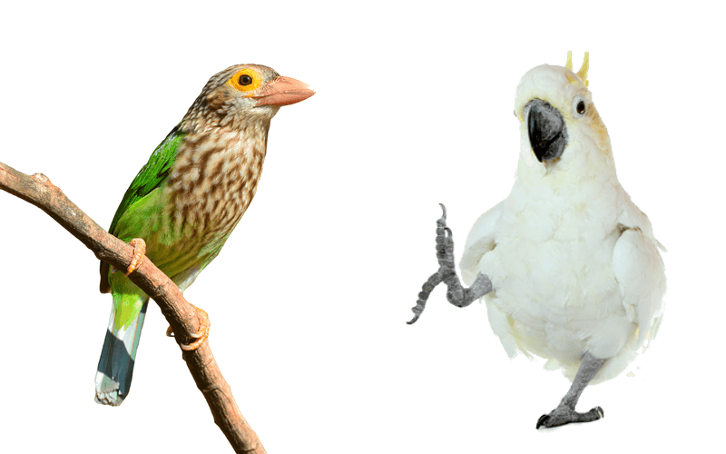
When he landed on the island of Lombok, Wallace was astonished to discover that the forest echoed with the raucous calls of cockatoos.
This was in stark contrast to the forests of Bali just 25 kilometres away, that contained Asian birds like barbets and fruit-thrushes.

Slide 8
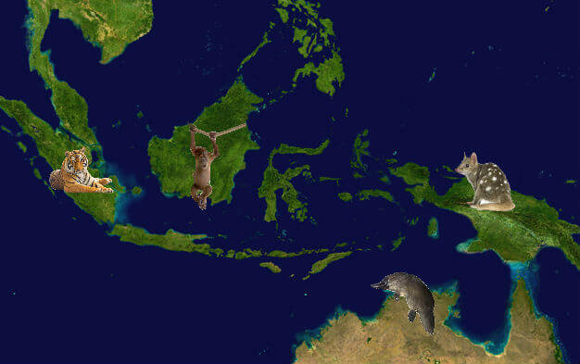
Wallace observed the same thing in mammals.
To the west (in Bali, Java and Borneo), orang-utans and tigers roamed the forests. To the east (in Lombok, New Guinea and Sulawesi), marsupials and egg-laying mammals (monotremes) could be found.

Slide 9
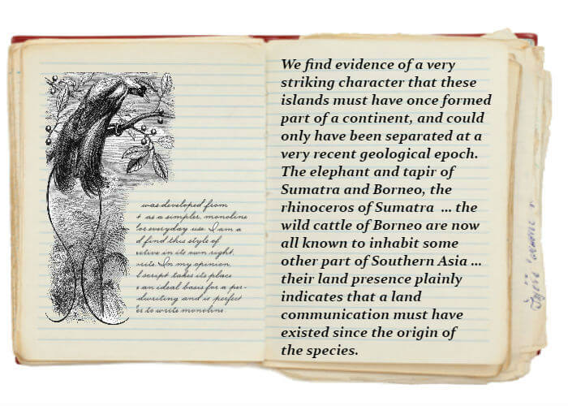
Why would a species found in Bali have similar traits to one found in Thailand (over 2,000 km away), and not to one found in Lombok (just 25 km away)?
Wallace did not have the knowledge we have today about geological change but he was beginning to think about it.

Slide 10
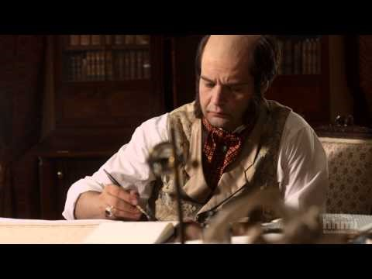

Slide 11
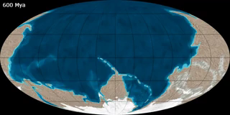
Why does this distinct line exist? To answer this question, we need to consider the role of plate tectonics and sea level change over Earth’s history.

Slide 12
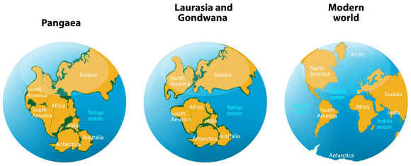
The surface of the earth is made up of many separate plates, which move gradually and continually at a rate of a few centimetres per year.
The continents are located on top of these plates, so as the plates move, so do the continents - this is known as plate tectonics.
The drift of continents is not noticeable in our lifetime, but over several million years, continents can travel much further apart!

Slide 13
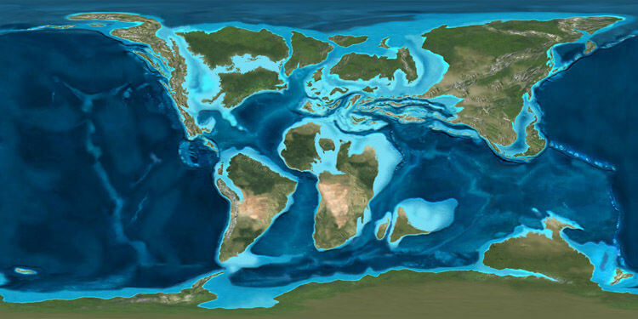
The Australian and Asian continents were once separated by a vast ocean.
The ocean that separated the two continents was so wide that it could not be crossed by species from either continents. Both groups evolved separately and remained in isolation from each other for millions of years.

Slide 14
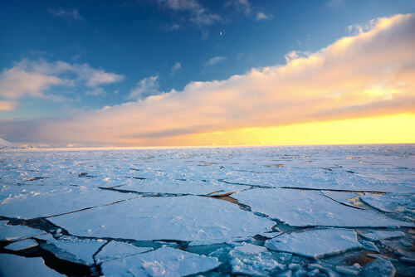
Sea level change is also responsible for the distribution of species found in the Malay Archipelago.
The Earth has had various sea levels throughout its history. Sea level is determined by the climate. When the climate is cooler, much of the seawater is contained in ice, which results in lower sea level. When the ice melts due to warmer climates, the sea level is higher.

Slide 15
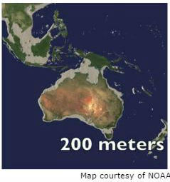
The last ice age was around 20,000 years ago. At this point, the sea level may have been around 200 metres lower than it is today.
When the sea level is low, more land is exposed. This exposed land acts as a bridge that organisms can cross. The grey areas in the image above represent these exposed land bridges.

Slide 16
Exposed land bridges occurred between Australia, New Guinea and the islands to the east of the Wallace Line, but did not extend to the west of the Wallace Line.
This is because the Wallace Line, which runs through the straits between Bali and Lombok, and Borneo and Sulawesi, is set upon deep ocean trenches. The sea level was never low enough for land bridges to form over these ocean trenches, preventing organisms from crossing over.
These ocean trenches therefore maintained the ecological divide set by the Wallace Line.

Slide 17
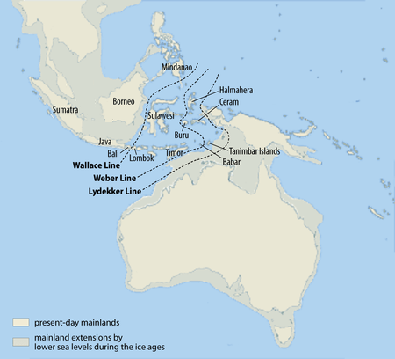
After Wallace, two naturalists named Max Weber and Richard Lydekker drew their biogeographical lines based on their own observations.

Slide 18
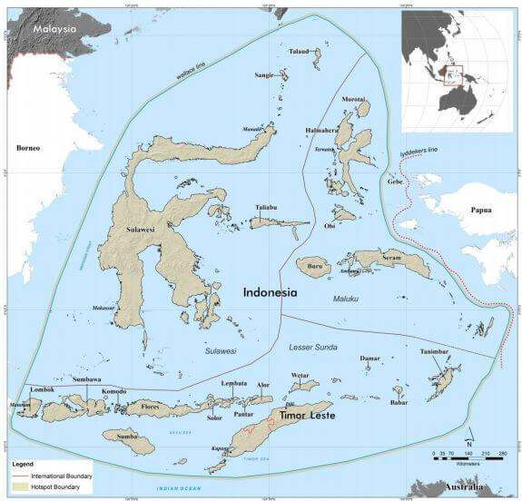
Because the distribution of different animal groups differ slightly, today’s biogeographers consider the area between these lines to be a transition zone.
This transition zone has been called Wallacea.

Slide 19
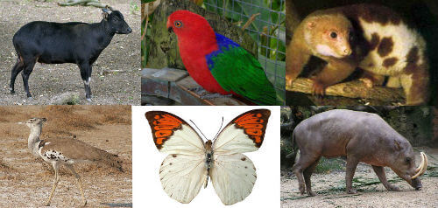
Wallacea is considered to be a biodiversity hotspot: an area known for its high species diversity.
Many of the plants and animals that live in the region are also endemic, meaning that they do not occur anywhere else in the world!

Slide 20
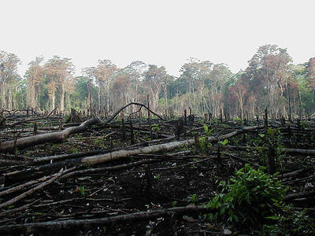
Wallacea is under pressure from intensive deforestation, pollution and climate change.
308 of its species are classified as threatened by the International Union for Conservation. However, the biodiversity of the area is not well known and it is likely that the true figure is much higher.

